Slide 1
Institute of Criminology
Crime in Times of the Pandemic
An Outline of Research Issues
1 April 2020
Manuel Eisner, Wolfson Professor of Criminology
Director of the Violence Research Centre (VRC)

Slide 2
Some Questions
What happens to crime during the pandemic?
How can we think theoretically about the issue?
What kinds of data do we need?
What research should we do?
How can we make a meaningful contribution to policy and prevention challenges?

Slide 3
The Timeline
China
17 Nov 2019 First confirmed case
23 January Lockdown in Wuhan and other cities starts
8 April Lockdown announced to end in Wuhan
UK
28 February First known transmission in the UK
11 March WHO declares COVID-19 a pandemic
16 March UK Government advises in social distancing and avoiding non-essential travel
18 March Close most schools
23 March Lockdown --- wide-ranging restrictions

Slide 4
The Issue
200 Countries
Different crime levels
Different social and political structures
Different health systems and resources
Different CJ systems
Different cultural values
The Pandemic
Variation in exposure to pandemic
Different responses
Unfolding change in responses
Variation in timing and duration of responses
Crime
Street crime
Domestic violence
Organised crime
Terrorism
CJ system responses
Social unrest
Compliance

Slide 5
What is affected by the pandemic?
Routine activities (streets, shops, schools, home).
Motivating emotions (Anger, Fear, Greed, Hatred, Compassion)
Prices and availability of goods (disinfectants, masks, food, drugs)
Interaction Costs (risk of infection)
Opportunities (online sales, empty premises, state funding schemes)
Formal and informal social control (emergency powers, police, public health apps, screening)
Strains (unemployment, loss/illness of loved ones, fear of future)

Slide 6
Overall Crime Levels
“Crime Plunges in New York City as Virus Lockdown Takes Hold”
NBC News
https://www.nbcnewyork.com/news/local/crime-and-courts/crime-plunges-in-new-york-city-as-virus-lockdown-takes-hold/2343578

Slide 7
Theory
Less Crime
Routine Activity Theory, Social Control Theory, Rational Choice Theory, Opportunity Theory…
…predict a decline in most conventional crime.
More Crime
Strain Theory probably predicts an increase in conventional crime.

Slide 8
New York, NBC News, 25 March 2020
“Citywide crime is down almost 17% compared to the same week last year, with dramatic drops in violent crime - shootings down 23.5%, rapes down 69% and assaults down 9%.”
“Crime in the subway, which had grown significantly so far this year, was down 33% last week compared to the year before.”
“Criminals are still stealing cars, as thefts were up 52% compared to the same week last year. That said, the recent trend had shown an increase of 75% for the past 28 days compared to last year, so even those numbers are a bit cooler.”
Cited from article:
https://www.nbcnewyork.com/news/local/crime-and-courts/crime-plunges-in-new-york-city-as-virus-lockdown-takes-hold/2343578/

Slide 9
London
Yesterday: calls to MPS 999 down around 33% compared to last year
Thanks to Simon Rose for personal communication

Slide 10
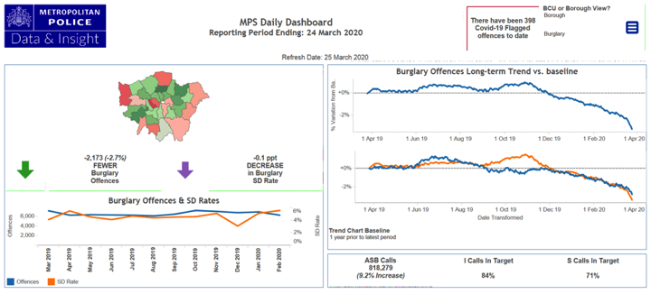
Burglary

Slide 11
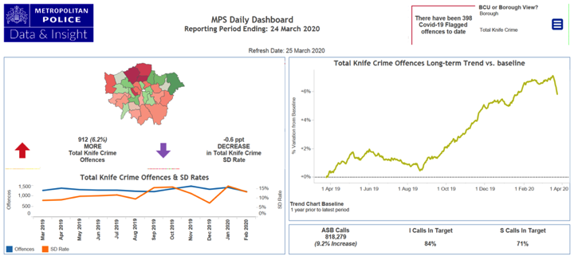
Knife Crime

Slide 12
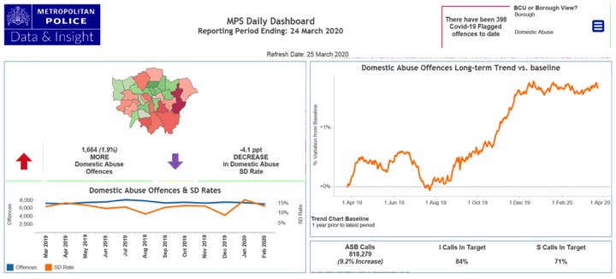
Domestic Abuse

Slide 13
Questions to Reflect on
Crime responds in complex ways to the most radical abrupt disruption in daily life across the world ever seen.
Crime changes will differ:
By crime type
By state-citizen relationship patterns
Between countries and their economic and cultural structures
Over time as the crisis continues.

Slide 14
The Example of Contagion Risk
The unknown risk of contagion adds interaction costs to:
Interaction in criminal groups
Attacks on victims, e.g. sexual assault
Street drug trafficking
Police interactions with citizens incl. arrest and interrogation
Courts and probation system
Prison interactions.

Slide 15
Different Causal Mechanisms may Operate at different time delays
Strains
Strength of Causal Mechanism
Opportunity Reduction
Time since start of lockdown

Slide 16
Looting and Violent Unrest

Slide 17
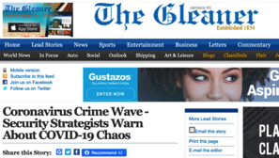
Looting and violent unrest?
Increasing food prices
Absolute poverty and hunger
Deserted warehouses
Declining state legitimacy
Jamaica
[Head of the Kingston Central Division Superintendent Maldria Jones-Williams] rebuffed reports reaching The Sunday Gleaner that wholesales downtown were being targeted for break-ins and looting, scenarios that security experts warned were not far off if the novel coronavirus public-health crisis persists.
Pakistan
Pakistan daily wagers struggle to survive in coronavirus lockdown
Daily wage workers and poor face hunger as authorities in Pakistan impose lockdown to check the spread of COVID-19
https://www.aljazeera.com/news/2020/03/pakistan-daily-wagers-struggle-survive-coronavirus-lockdown-200325115143152.html

Slide 18
Domestic Violence
Domestic Violence
?
Street Violence

Slide 19
Warnings
“For many French women and families suffering from domestic violence, being confined at home with an abusive partner due to the coronavirus is set to become a living nightmare.”
https://www.france24.com/en/20200325-trapped-at-home-domestic-violence-victims-at-high-risk-in-coronavirus-confinement
“Coronavirus: Rise in domestic abuse incidents during COVID-19 outbreak, police leader warns”
SkyNews
“Southern Weekly (a major Chinese journalism media) that a local women's right NGO in Hubei Jianli County reported having received a total of 175 domestic violence cases in February 2020, which is double the number in January, and three times higher than the same month last year (i.e., Feb 2019).”
Thanks a lot to Lu Liu

Slide 20
The Theory
Intimate Partner Violence
More time with abusers, more tensions and conflicts, more strains, more alcohol and drugs consumed at home, fewer opportunities to call for help.
Violence against Children
Children longer at home, more conflicts among siblings, more tensions, more negative emotions, more stressed parents, more anger.

Slide 21
Questions to Reflect on…
Calling for help much more difficult. ATM no self-report studies.
Multiple potential causal mechanisms.
Also possible IPV and VAC reducing effects
Less substance use?
More community cohesion and supervision
Prevention and intervention. Several initiatives - limited knowledge about effectiveness.
Level and nature of domestic violence may change as the lockdown continues.

Slide 22
Organised Crime
“When the economy collapses or is in a shutdown, organized crime also suffers,” said Federico Varese, a professor at Oxford University.
Organized Crime and Corruption Reporting Project
https://www.occrp.org/en/blog/11905-cocaine-corona-how-the-pandemic-is-squeezing-italian-crime-groups

Slide 23
The Pandemic and Organised Crime/White Collar Crime
Challenges | Opportunities
Reduced spatial mobility Distribution of drugs more difficult Decline of prostitution market | Loan sharks Corruption Abuse of state funding Insider trading Illegal medicine Illegal evictions Black markets Gambling industry Online distribution of drugs, dark web

Slide 24
Should Organised Crime be Concerned?
“The coronavirus has hit the New York mafia like a blow, drastically reducing the chances of doing criminal activity and, therefore, the revenue.”
Thanks to Paolo Campana. USA - Il Padrino in ginocchio, il virus una mazzata sulla mafia di Ny
https://www.ansa.it
“Because of the coronavirus, there is very little distribution or importation from China to Mexico City. It’s difficult to get the chemicals, the juice. You can get them, but the prices are going way up for everyone.”
https://www.vice.com/en_uk/article/bvgazz/sinaloa-cartel-drug-traffickers-explain-why-coronavirus-is-bad-for-business

Slide 25
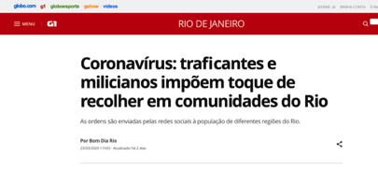
Organised Crime Provides Better Quality Protection in Rio de Janeiro
"Attention all residents of Rio das Pedras, Muzema and Tijuquinha !!! Curfew from 20:00 today. Whoever is seen on the street after this time will learn to respect the next one !!!".
Thanks to Nico Trajtenberg
https://g1.globo.com/rj/rio-de-janeiro/noticia/2020/03/23/coronavirus-traficantes-e-milicianos-impoem-toque-de-recolher-em-comunidades-do-rio.ghtml

Slide 26
Questions to Reflect on…
What side-effects does the lockdown have on organised crime?
Will there be new lasting structures linked to, e.g., black markets for food, fake treatments?
What effects will the financial policies have on fraud and white collar crime?

Slide 27
The State and its Citizens:
Police, Prisons and Justice System

Slide 28
Surveillance and Social Control
We are seeing the most dramatic infringement on civil liberties ever.
Face recognition systems (China, Russia)
GPS tracking systems (South Korea)
Big Data Monitoring
Authoritarian lockdown policing with high public consent (e.g. India, Peru, Pakistan)
Suspension of democracy (Coronavirus coup in Hungary)
Is this a lasting revolution in the spread of surveillance technologies around the world (like 9/11)?

Slide 29
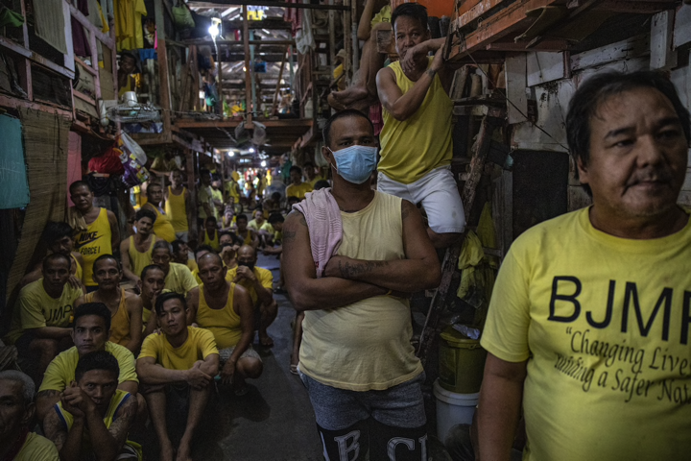
CJ Issues
Concerns about human rights abuses
Policing the lockdown binds a lot of resources
Reduced staffing levels across the systems
Cessation of courts and processing of cases
Victim support and 999 services strained
Riots in prisons linked to constraints on visits
Italy, Colombia, Brazil
Release of prisoners (Iran, Northern Ireland, US, Colombia)
“Iran has temporarily freed about 85,000 prisoners in an effort to combat the spread of coronavirus, a judiciary spokesman in the country has said”

Slide 30
Compliance with Public Health Instructions:
Authoritarian Control or Consent to Comply?

Slide 31
The Normative and Policy Question
Is there a moral difference between risking to kill somebody as a consequence of drunk driving and risking to kill somebody as a consequence of knowingly exposing others to the COVID-19?
How can compliance be achieved?
What levels of surveillance and control are acceptable?
How good is knowledge in the sense of health literacy?

Slide 32
Compliance between Criminology and Public Health Research
Widespread reports of lacking compliance with self-isolation, social distancing, travel restrictions, hygiene guidance, anti panic-buying guidance, etc.
Population-wide policing of compliance impossible.
Important questions relating to:
Who complies with guidance?
Which messaging can improve compliance?
How does compliance change as the lockdown continues?
Do different approaches result in different levels of compliance?

Slide 33
Our Contribution
Study 1 A Rapid Response Study linked to the z-proso longitudinal study.

Slide 34
An online survey integrated into the Zurich Project on Social Development from Childhood to Adulthood
On-going longitudinal study of 1500 participants, last assessment at age 20, now aged 23.
Collaboration of psychiatry, sociology, psychology, criminology in Zurich, Cambridge, Edinburgh. Lead by Jacobs Center at UZH.
Brief (15 mins) on-line questionnaire.
Repeated every 3 weeks, starting in two weeks.
www.vrc.crim.cam.ac.uk/vrcresearch/z-proso and https://www.jacobscenter.uzh.ch/en/research/zproso.html

Slide 35
Ethical and Practical Issues
Fast response add-on funding, proposal submitted within 24 hours, decision expected in the next days.
Use of existing data management infrastructure with Qualtrics as backbone.
Complex ethical considerations:
Speed matters ethically
What can one ask?
Provision of counselling and advice information. How?

Slide 36
Domains measured (amongst others)
Experienced trauma/adversity/constraints
Compliance with public health instructions
Mental health: anxiety, depression, irritability, anger
Legitimacy, moral neutralisation
Substance use, gambling, domestic conflict
Resilience and positive experiences: helping, social networks, deceleration

Slide 37
Some Questions
What are levels of compliance, are there systematic group differences and what factors predict compliance (including general criminal propensity)?
How does strain experienced during the pandemic affect anger, irritability, and depression, which in turn may increase levels of conflict.
How does the lockdown affect gambling, alcohol use, self-medication, illicit substance use, etc?

Slide 38
Conclusions: Our Challenges
All types of crime will be profoundly affected by the current crisis. The very foundations of social order are at stake.
Criminologists should take up the challenge through:
High-quality new research.
Adaptation, where possible, of ongoing studies.
Focussing on policy-relevant issues.
Synthesizing existing knowledge.
Collaborating across countries and disciplines.
Series of Seminars?
Special Issue?
Task Force - Global Information System

