Slide 1
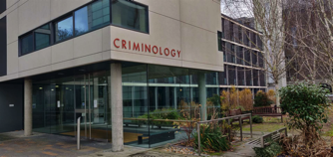

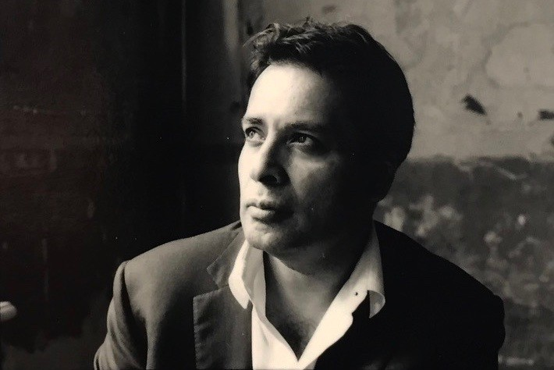
INSTITUTE OF CRIMINOLOGY
Public Webinar, Friday 24 July 2020, 15:00 - 16:00
The Killing of George Floyd: "Race", racism and racialised justice in the US and UK
Speaker:
Dexter Dias, QC
Convenor
Prof Manuel Eisner
Director, VRC
www.vrc.crim.cam.ac.uk/
Welcome everybody!

Slide 2
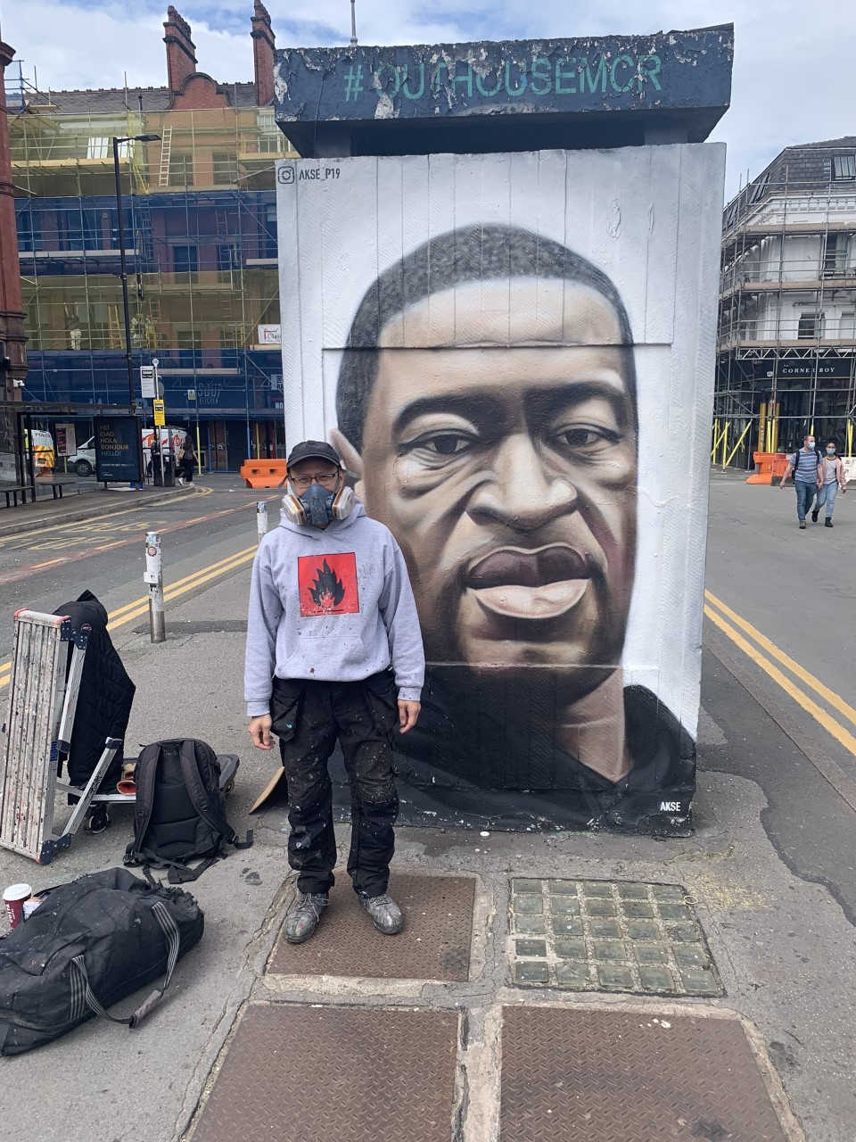
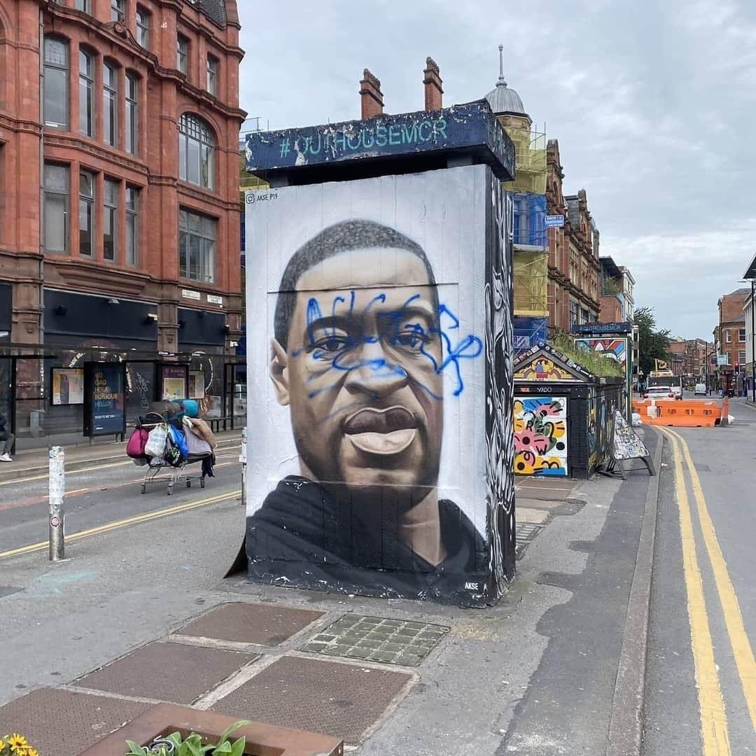
Media used during the talk
INSTITUTE OF CRIMINOLOGY
YouTube clip: play from 34 secs for about 1min: https://youtu.be/M_KVsbIgVlI
Twitter clip:
pic.twitter.com/rFB5X0bTC6
Youtube clip:
https://youtu.be/ybDa0gSuAcg

